Slide 1
Customer Retention
Problem Statement:
E-retail factors for customer activation and retention: A case study from Indian e-commerce customers
Customer satisfaction has emerged as one of the most important factors that guarantee the success of online store; it has been posited as a key stimulant of purchase, repurchase intentions and customer loyalty. A comprehensive review of the literature, theories and models have been carried out to propose the models for customer activation and customer retention. Five major factors that contributed to the success of an e-commerce store have been identified as: service quality, system quality, information quality, trust and net benefit. The research furthermore investigated the factors that influence the online customers repeat purchase intention. The combination of both utilitarian value and hedonistic values are needed to affect the repeat purchase intention (loyalty) positively. The data is collected from the Indian online shoppers. Results indicate the e-retail success factors, which are very much critical for customer satisfaction.
Be careful: There are two sheets (one is detailed) and second is encoded in the excel file. You may use any of them by extracting in separate excel sheet. The number of column(s) is more than 47. Read the column header carefully.
Note : Data Scientists have to apply their analytical skills to give findings and conclusions in detailed data analysis written in jupyter notebook . Only data analysis is required.
Need not to create machine learning models /but still if anybody comes with it that is welcome.

Slide 2
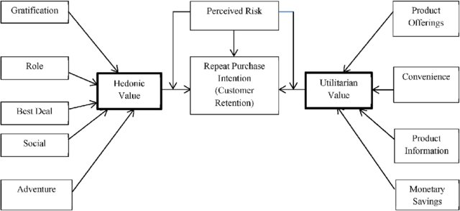

Slide 3



DATA
Customer Dataset who shops online from different websites
71 VARIABLES
269 OBSERVATIONS

Slide 4
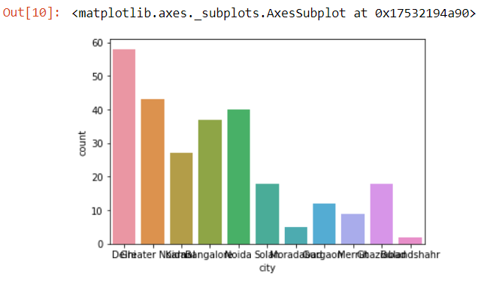
Exploratory Data Analyses
1.
BUSINESS RECOMMENDATIONS : -
Most of the Customers are from Delhi

Slide 5
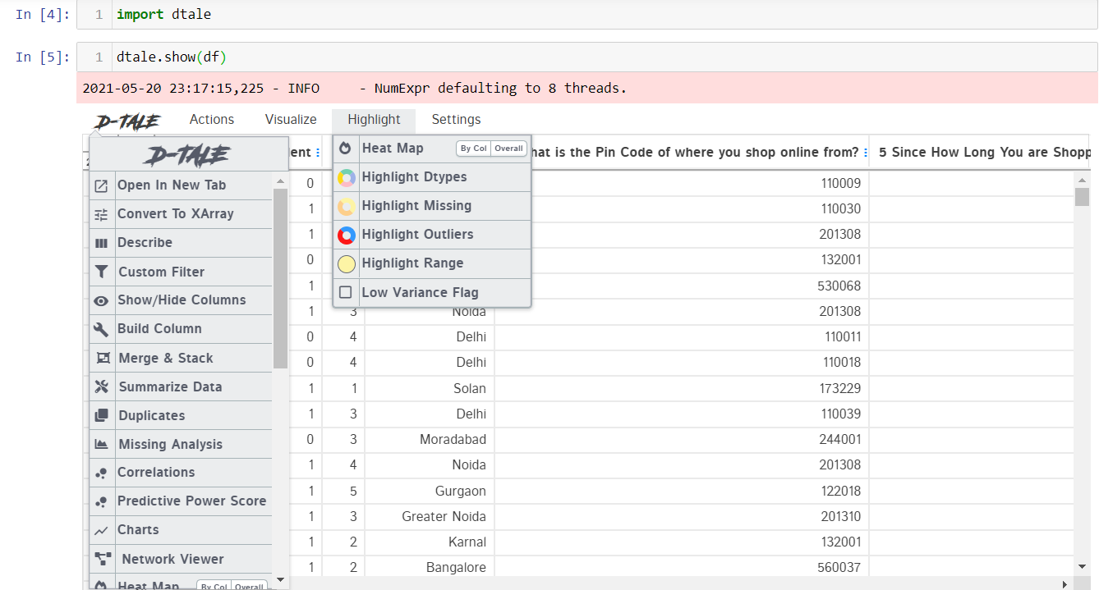
2.
Dtale is the pandas Library Used for visualization, with the help
of this we are able to describe the data, visualize the data, find any
missing value, find correlation etc.

Slide 6
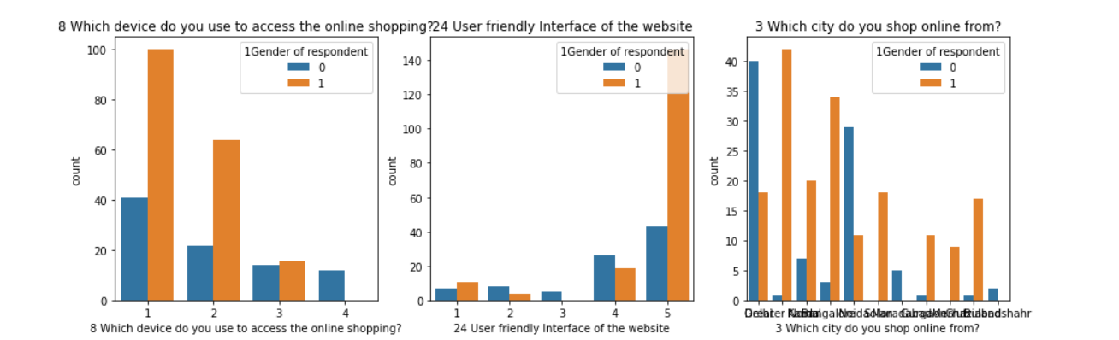
3.
BUSINESS RECOMMENDATIONS : -
- Most of the Customers are use smartphones.
- Most of the Customers Strongly agree that they have friendly interface of the website.

Slide 7
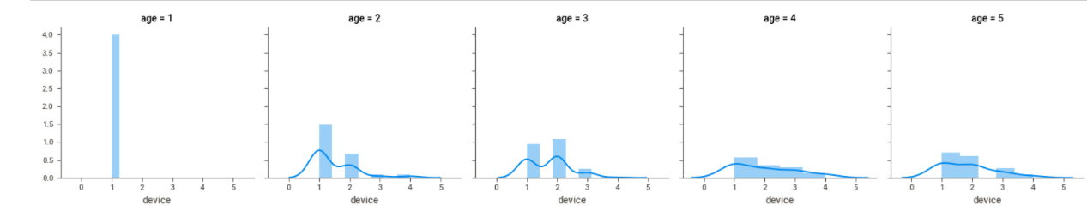
4.
BUSINESS RECOMMENDATIONS : -
Customers who is less than 20 years uses smartphone.
Customers within age 21-30 uses smartphone and laptops.

Slide 8
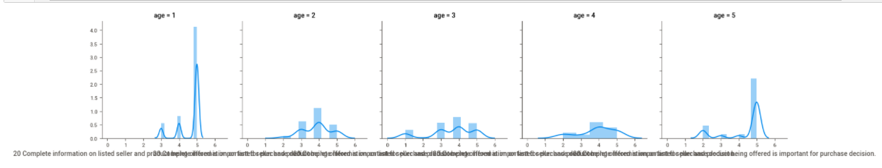
5.
BUSINESS RECOMMENDATIONS : -
In the Age group which is more than 30 years there are some people who disgree about the information given about the seller is correct .

Slide 9
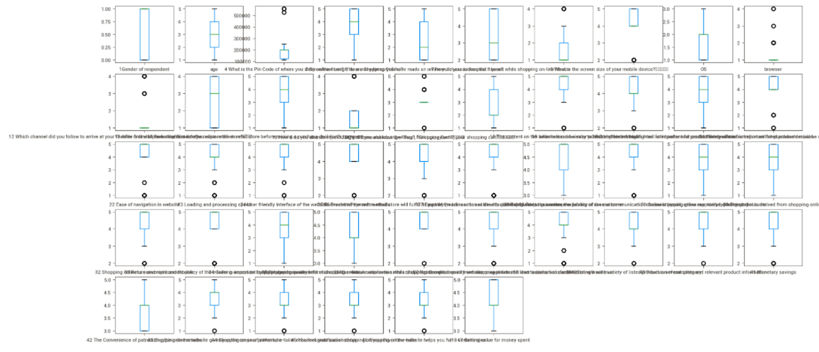
6. OUTLIERS:
- There are small no. of outliers in each column.

Slide 10

7. PAIRPLOT:

Slide 11
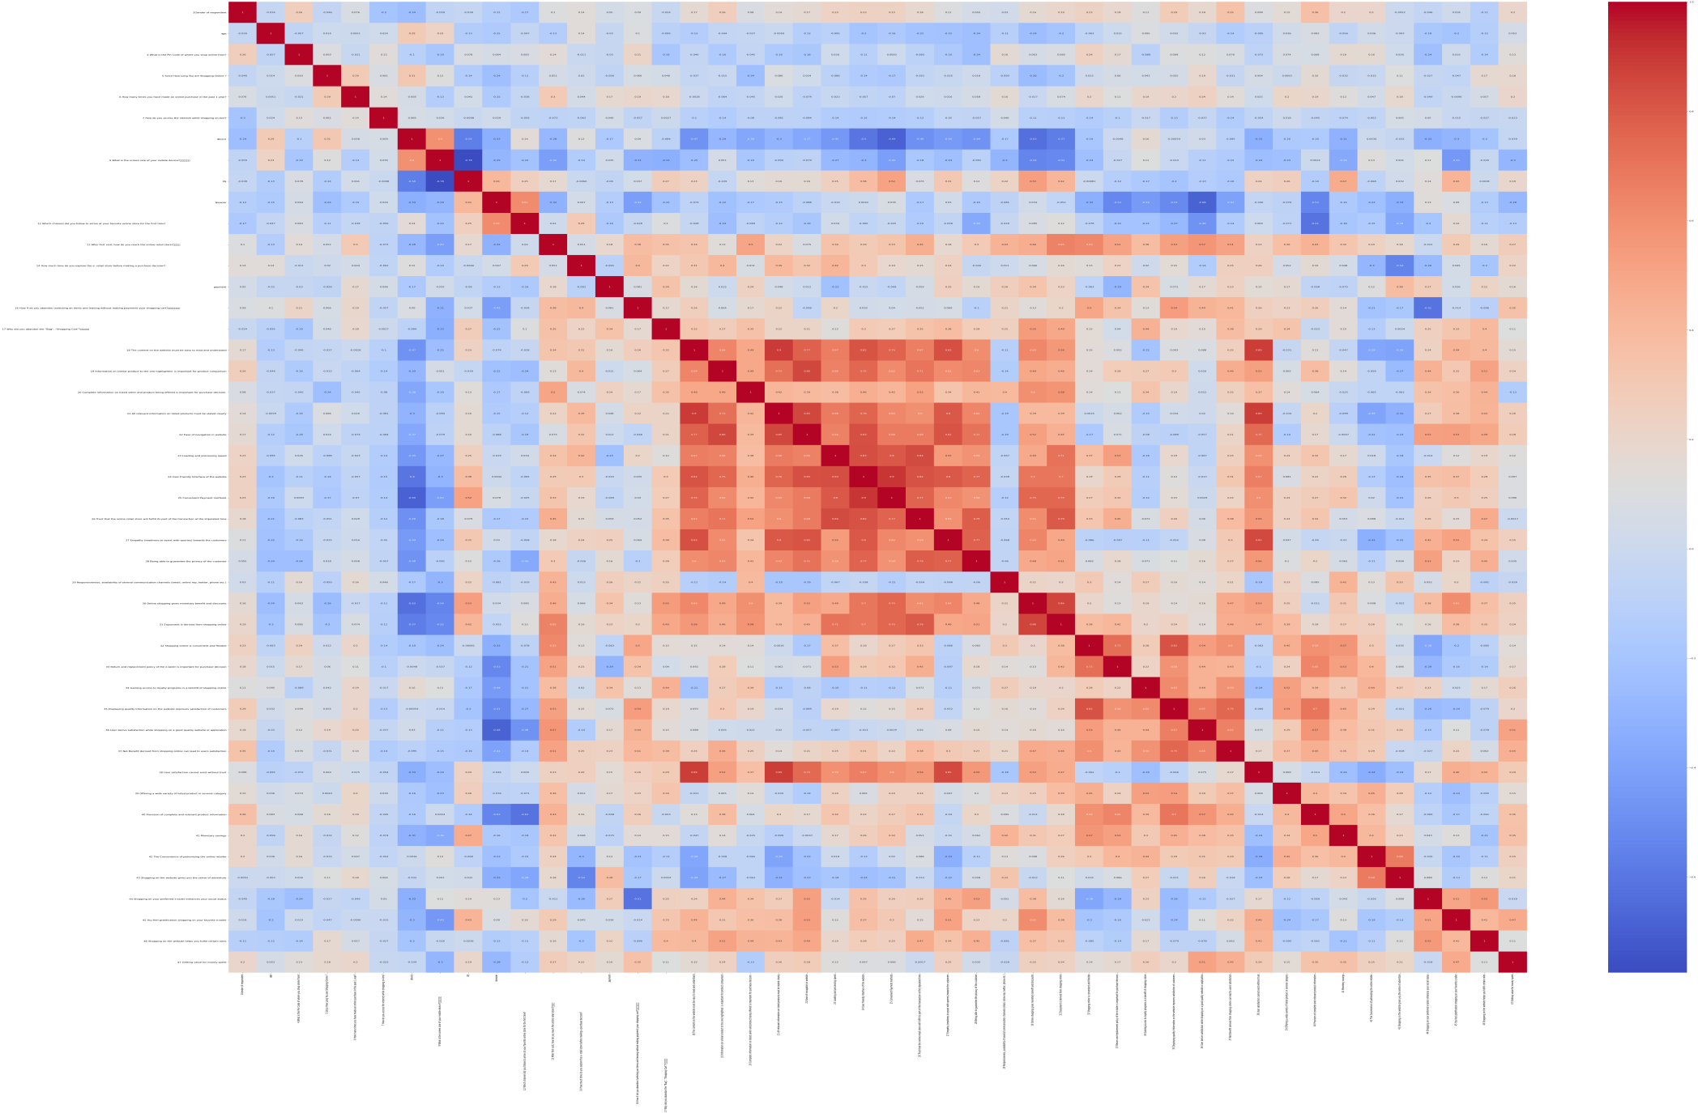
Peason Correlation

Slide 12
Correlation:
“The Convenience of patronizing the online retailer” is highly correlated with The “Shopping on the website gives you the sense of adventure.”
“Provision of complete and relevant product information” is highly correlated with “Displaying quality Information on the website improves satisfaction of customers”

Slide 13
Assumptions used to complete the project:
Customer retention refers to the actions and strategies a business uses to try and keep existing customers. To enable these actions, customer retention analytics provide predictive metrics of which customers might churn — which enables them to get ahead of it.
Machine learning is one of the least adopted practices in customer programs (38% of companies). Seemingly, customer professionals lack proficiency in, or access to, three important data science skills: programming, mathematics, statistics. Customer professionals said their biggest barrier was the inability of translating customer insights into business operations.

Slide 14
Conclusion:
Key Findings and Conclusions of the Study:
Key findings are that, the EDA process helps us to understand the problem well through visualizations and data cleaning, this will further help us in model building purpose and gaining the maximum accuracy score.
Through EDA process we can see that there are some columns which are not needed and there are some outliers to be removed so that the accuracy should be maintained.
Also there are high correlation between some columns . Therefore we can visualize and check the relationship between that columns.
Learning Outcomes of the Study in respect of Data Science
- Firstly visualization helps us in various forms as follows:
1.Communicate Findings in Constructive Ways
2.Understand Connections Between Operations and Results
3. Interacting With Data
4. Create New Discussion
- Secondly, after applying algorithms we can see which algorithm performs better and gives better prediction.
We can also use ensembling techniques to improve the accuracy of the models build.

